Slide 1


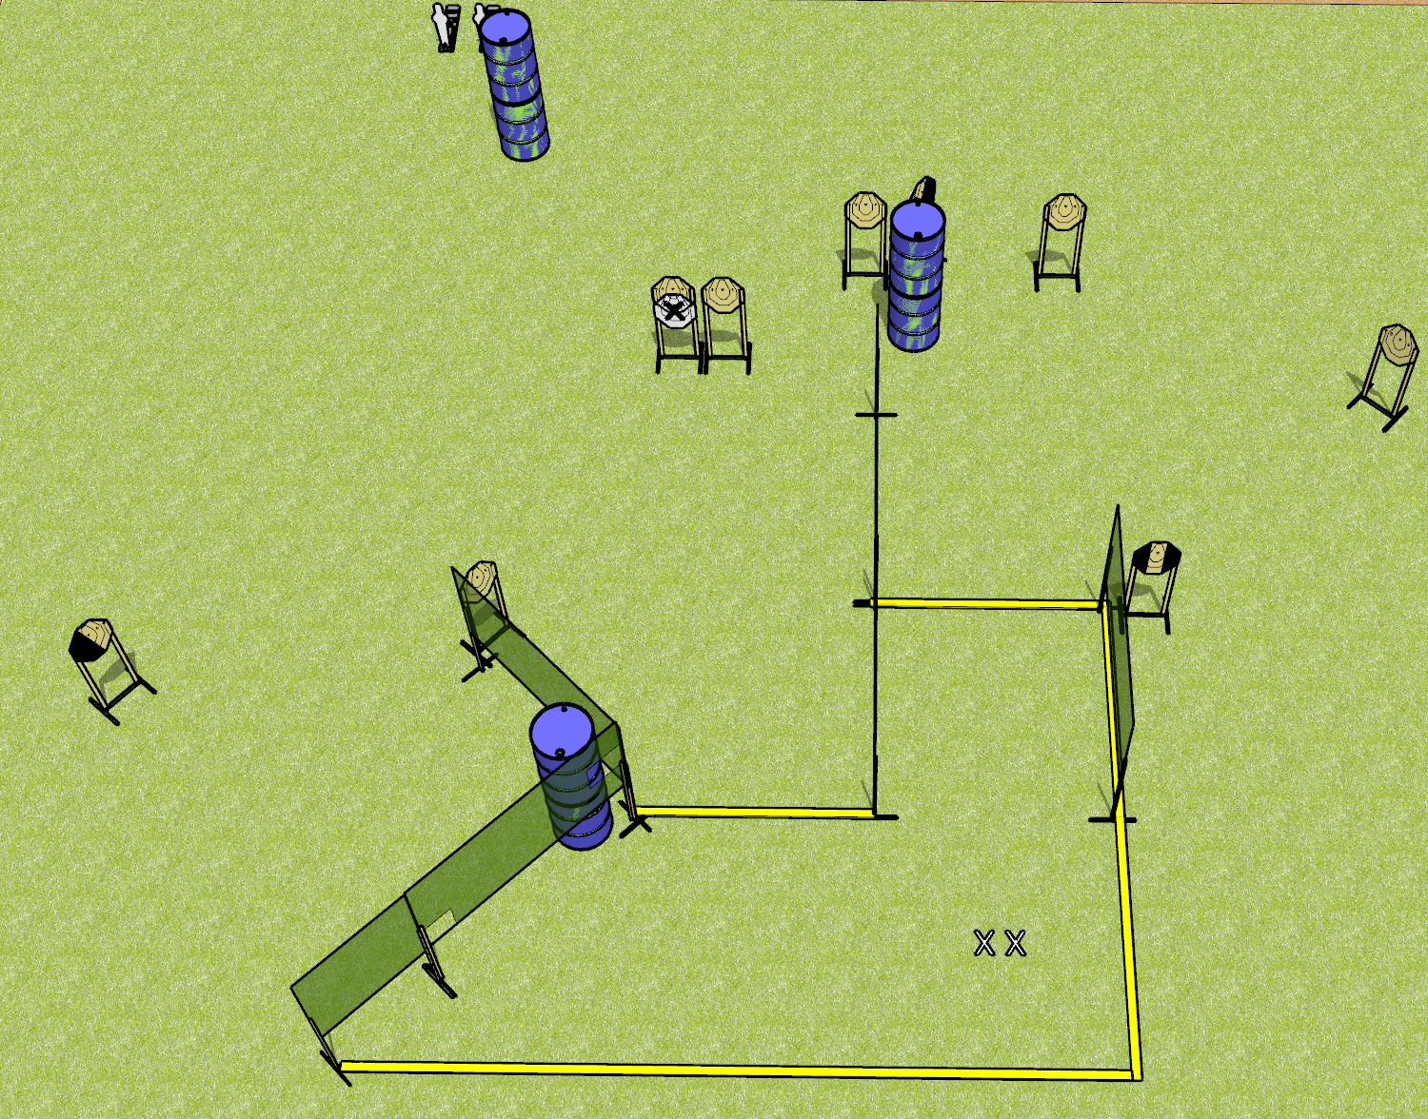
 | Dothan Gun Club – USPSA Match Digging In Course Designer : Drew Coleman
20 rounds 9 IPSC 2 mini poppers
Equipment List 9 wall feet 1 medium fault line

Slide 2
Digging In
Written Stage Briefing
Digging In is a 20 round, 100 point, Comstock course of fire. There are 9 IPSC targets and 2 mini poppers. The best 2 hits on paper will score, and steel must fall to score. The start signal is audible.
Handgun start position is both feet on X’s, wrists below belt. Handgun is loaded and holstered.
PCC start position is both feet on X’s. Loaded carbine is held with both hands, stock on belt, safety on.
On start signal, engage targets as they become available from within the shooting area.

